Slide 1
The History of Math
From Ancient to Modern Times

Slide 2
Please Note:
There will be moments you have no idea what the videos are talking about.
THAT’S OK!
You might want to watch this with family members so you can talk about it as you’re watching. They might have no idea what they are talking about either.
THAT’S OK!
You might enjoy this more if you watch one video per day!

Slide 3
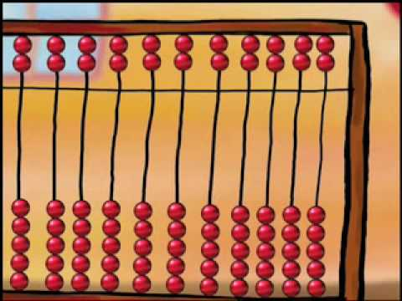
An animated movie on the development of numbers throughout history.

Slide 4
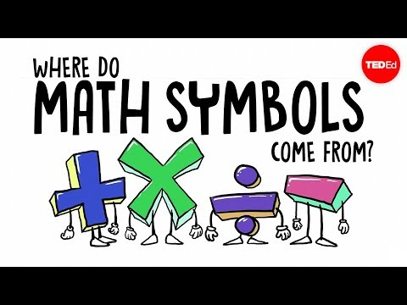
Math is full of symbols: lines, dots, arrows, English letters, Greek letters, superscripts, subscripts ... it can look like an illegible jumble. Where did all of these symbols come from? John David Walters shares the origins of mathematical symbols, and illuminates why they’re still so important in the field today.

Slide 5
Would mathematics exist if people didn't? Did we create mathematical concepts to help us understand the world around us, or is math the native language of the universe itself? Jeff Dekofsky traces some famous arguments in this ancient and hotly debated question.

Slide 6
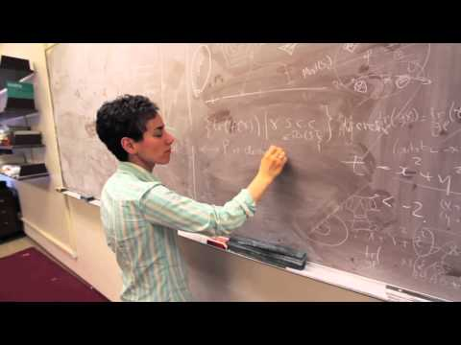
Maryam Mirzakhani wins 2014 Fields medal. The medal was first awarded in 1936 to the Finnish mathematician Lars Ahlfors and the American mathematician Jesse Douglas, and it has been awarded every four years since 1950. Its purpose is to give recognition and support to younger mathematical researchers who have made major contributions.Maryam is the first woman to receive it.

Slide 7
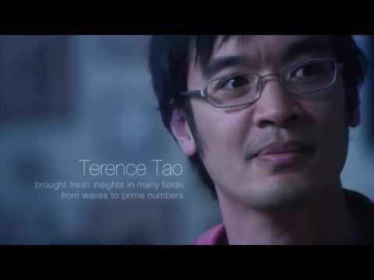
What do mathematicians do now? Why do they do it?

Slide 8
For the insatiably curious….BONUS!
The entire field of mathematics summarised in a single map! This shows how pure mathematics and applied mathematics relate to each other and all of the sub-topics they are made from.

