Slide 1
History of Non-Euclidean Geometry
By Extra History

Slide 2
Please Note:
There will be moments you have no idea what he’s talking about.
THAT’S OK!
You might want to watch this with family members so you can talk about it as you’re watching. They might have no idea what he’s talking about either.
THAT’S OK!
You might enjoy this more if you watch one video per day!

Slide 3
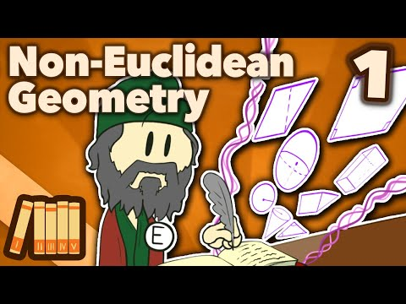
Before we get into non-Euclidean geometry, we have to know: what even is geometry? What's up with the Pythagorean math cult? Who was Euclid, for that matter? And what the heck is the 5th Postulate?

Slide 4
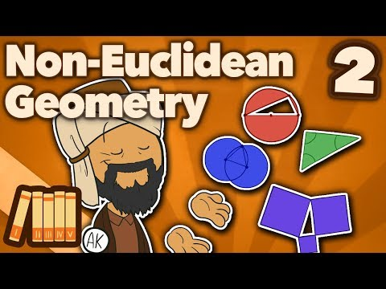
For hundreds of years, Euclid's geometry disappeared with the fall of the Roman Empire. But in Constantinople, Islamic mathematicians, including Al-Khwarizmi (who gave us the word "algebra") worked long and hard on proving the Fifth Postulate.

Slide 5
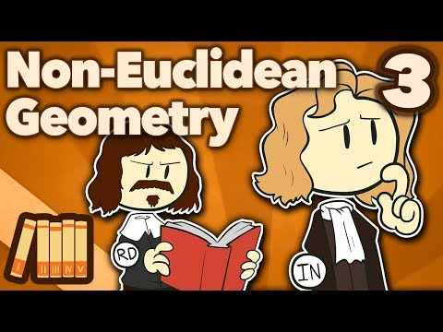
Euclidean geometry eventually found its way back into Europe, inspiring René Descartes to create the Cartesian coordinate system for maps, and Isaac Newton to invent calculus. Both these tools helped humanity understand the world better.

Slide 6
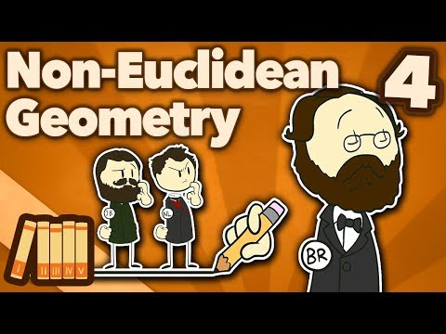
In the early 19th century, people started to wonder if the Fifth Postulate couldn't be proven at all--meaning that it could be right, but it could also be wrong. Bolyai, Lobachevsky, and Riemann started exploring hyperbolic geometry and other strange realms...

Slide 7
Up until the 20th century, people assumed light behaved like a wave, passing through the "aether wind"--a fluid with incomprehensible properties. When the Michelson-Morley experiment disproved the aether's existence, Einstein put out the theory of relativity--that space and time were part of the same package.

Slide 8
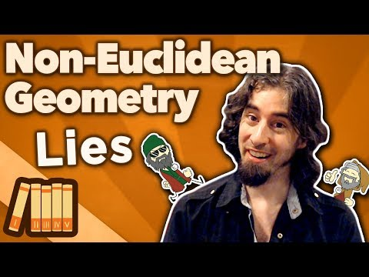
You gently corrected out our math mistakes and artistic slip-ups, and we're here to tell you it was all part of Bismarck's plans--er, it's Euclid's fault. Time for another episode of Lies!

