Slide 1
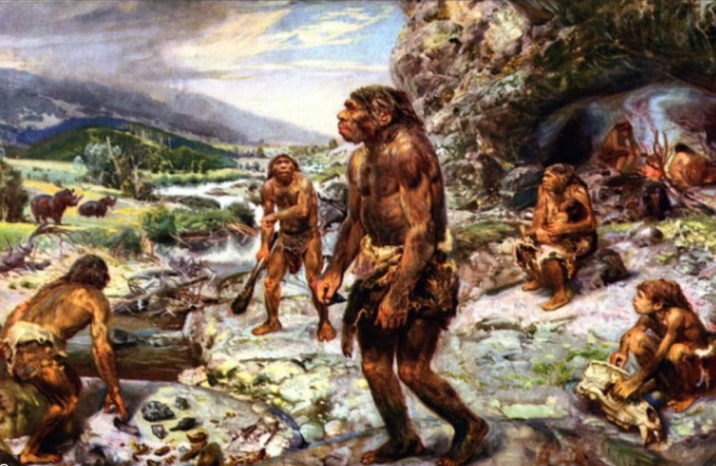
Prehistoric Math

Slide 2
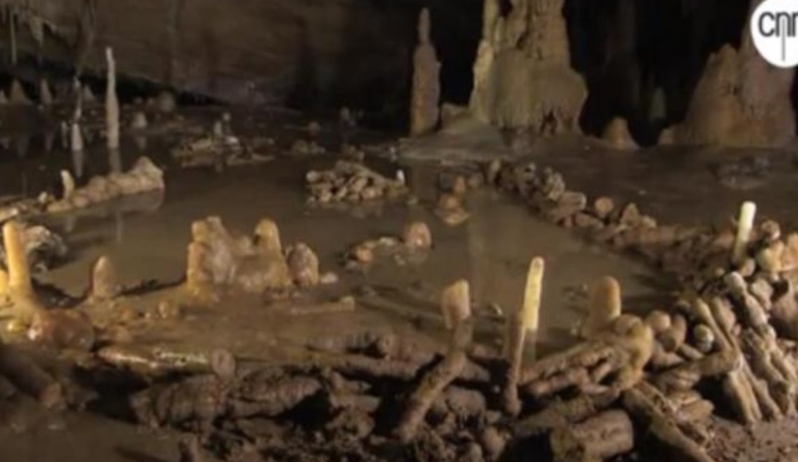
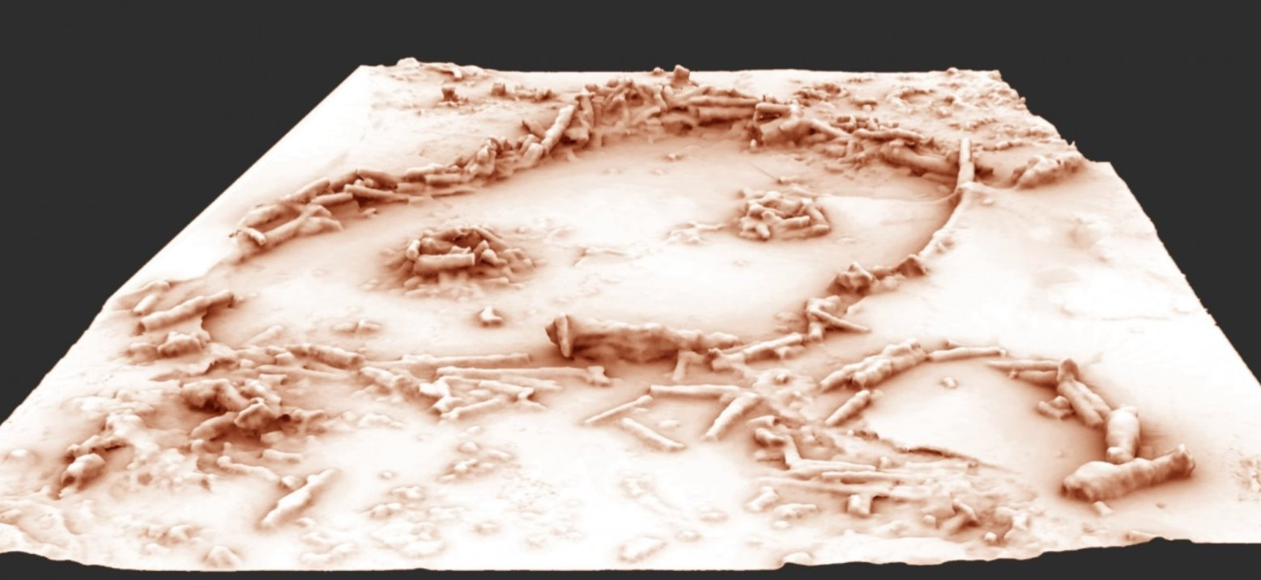
Bruniquel Cave – France – 176,000 years old

Slide 3
Lebombo – Africa – 43,000 Years Old

Slide 4
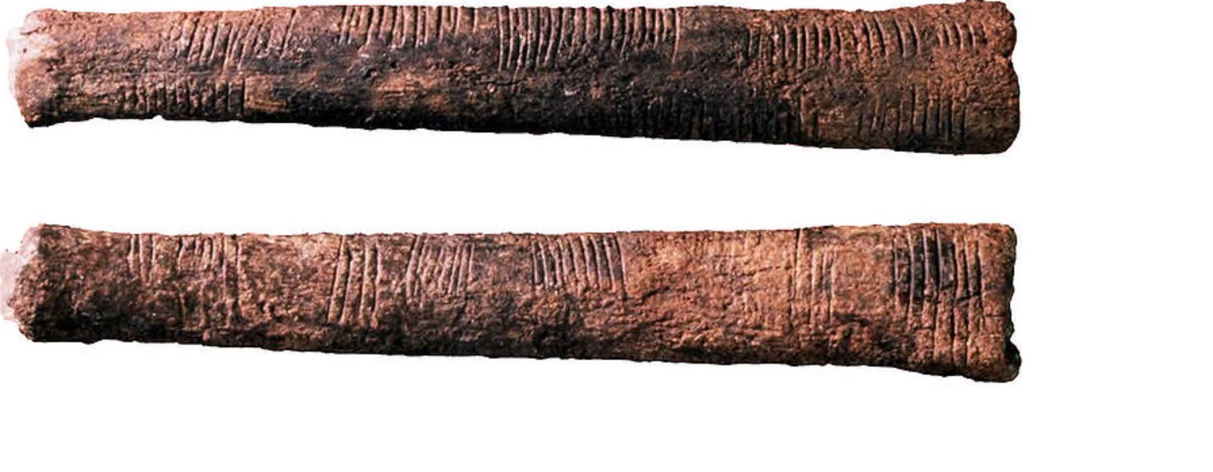
Ishango Bone – Africa –20,000 years old

Slide 5
Sketch of Lebombo Bone
Sketch of Ishango Bone

Slide 6
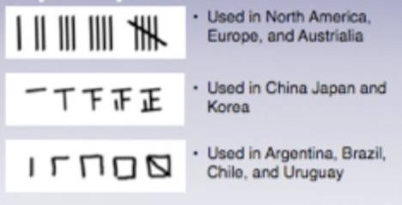
Tally Systems
Make Up Your Own!

Slide 7
Notes
France
What shapes do you notice? What do you think they used to make those shapes?
Is this above ground or below ground? What is significant about where this was made?
What do you think they did here?
Africa
What do you think these were made of? Why?
What did you notice about the markings?
What do you think they were used for?
Timeline:
What year (approximately) were each of these from?

Slide 8
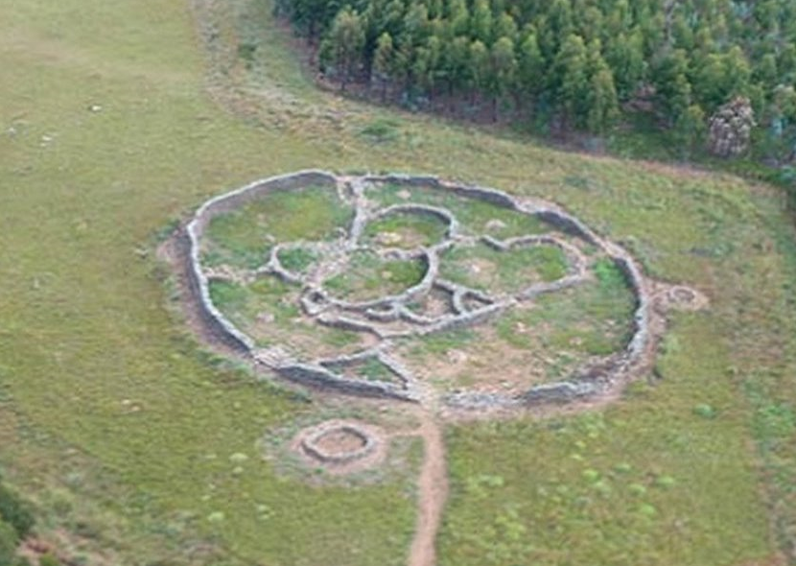
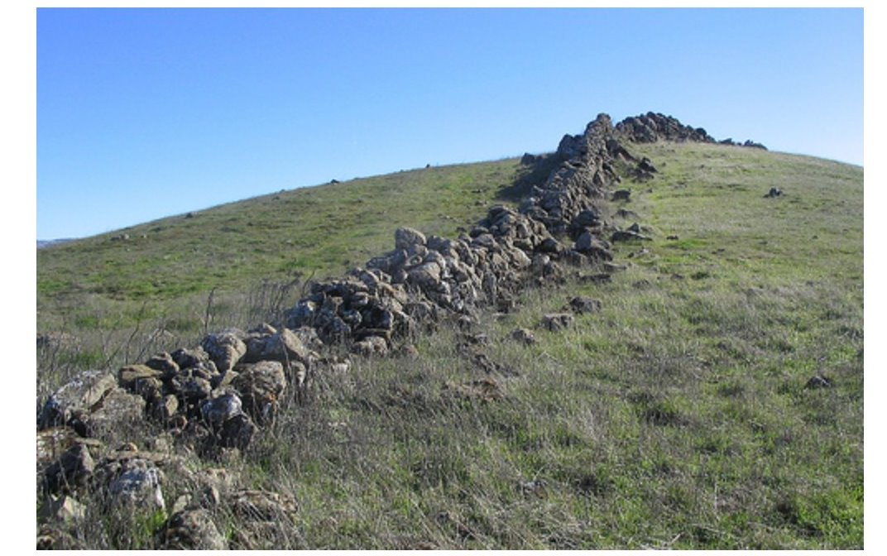
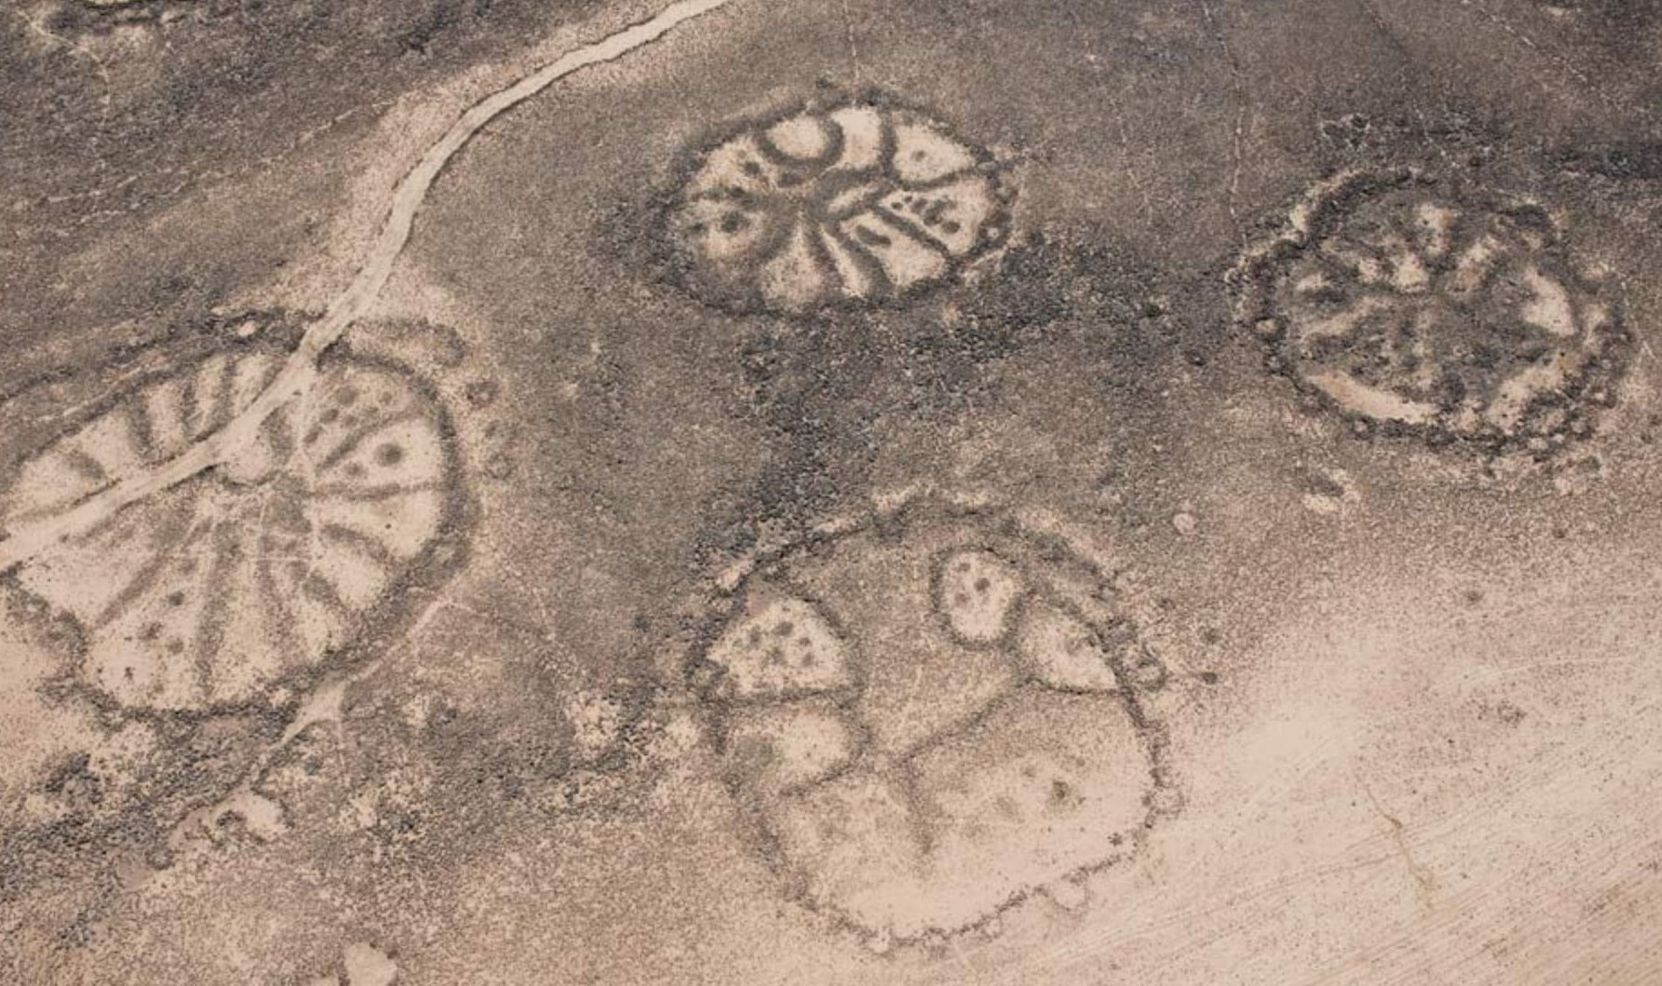
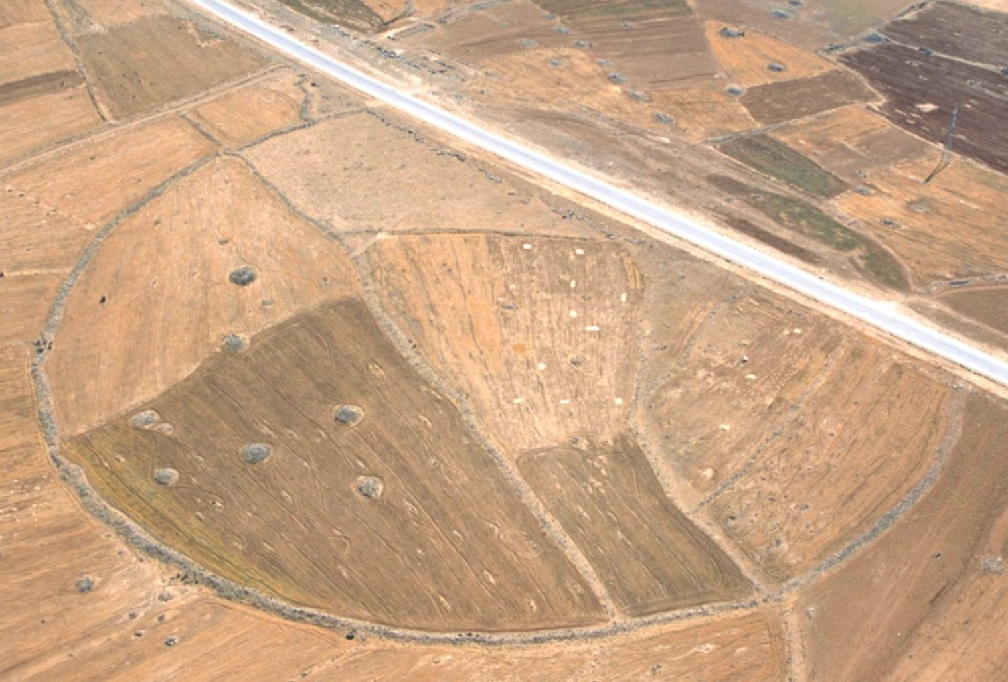
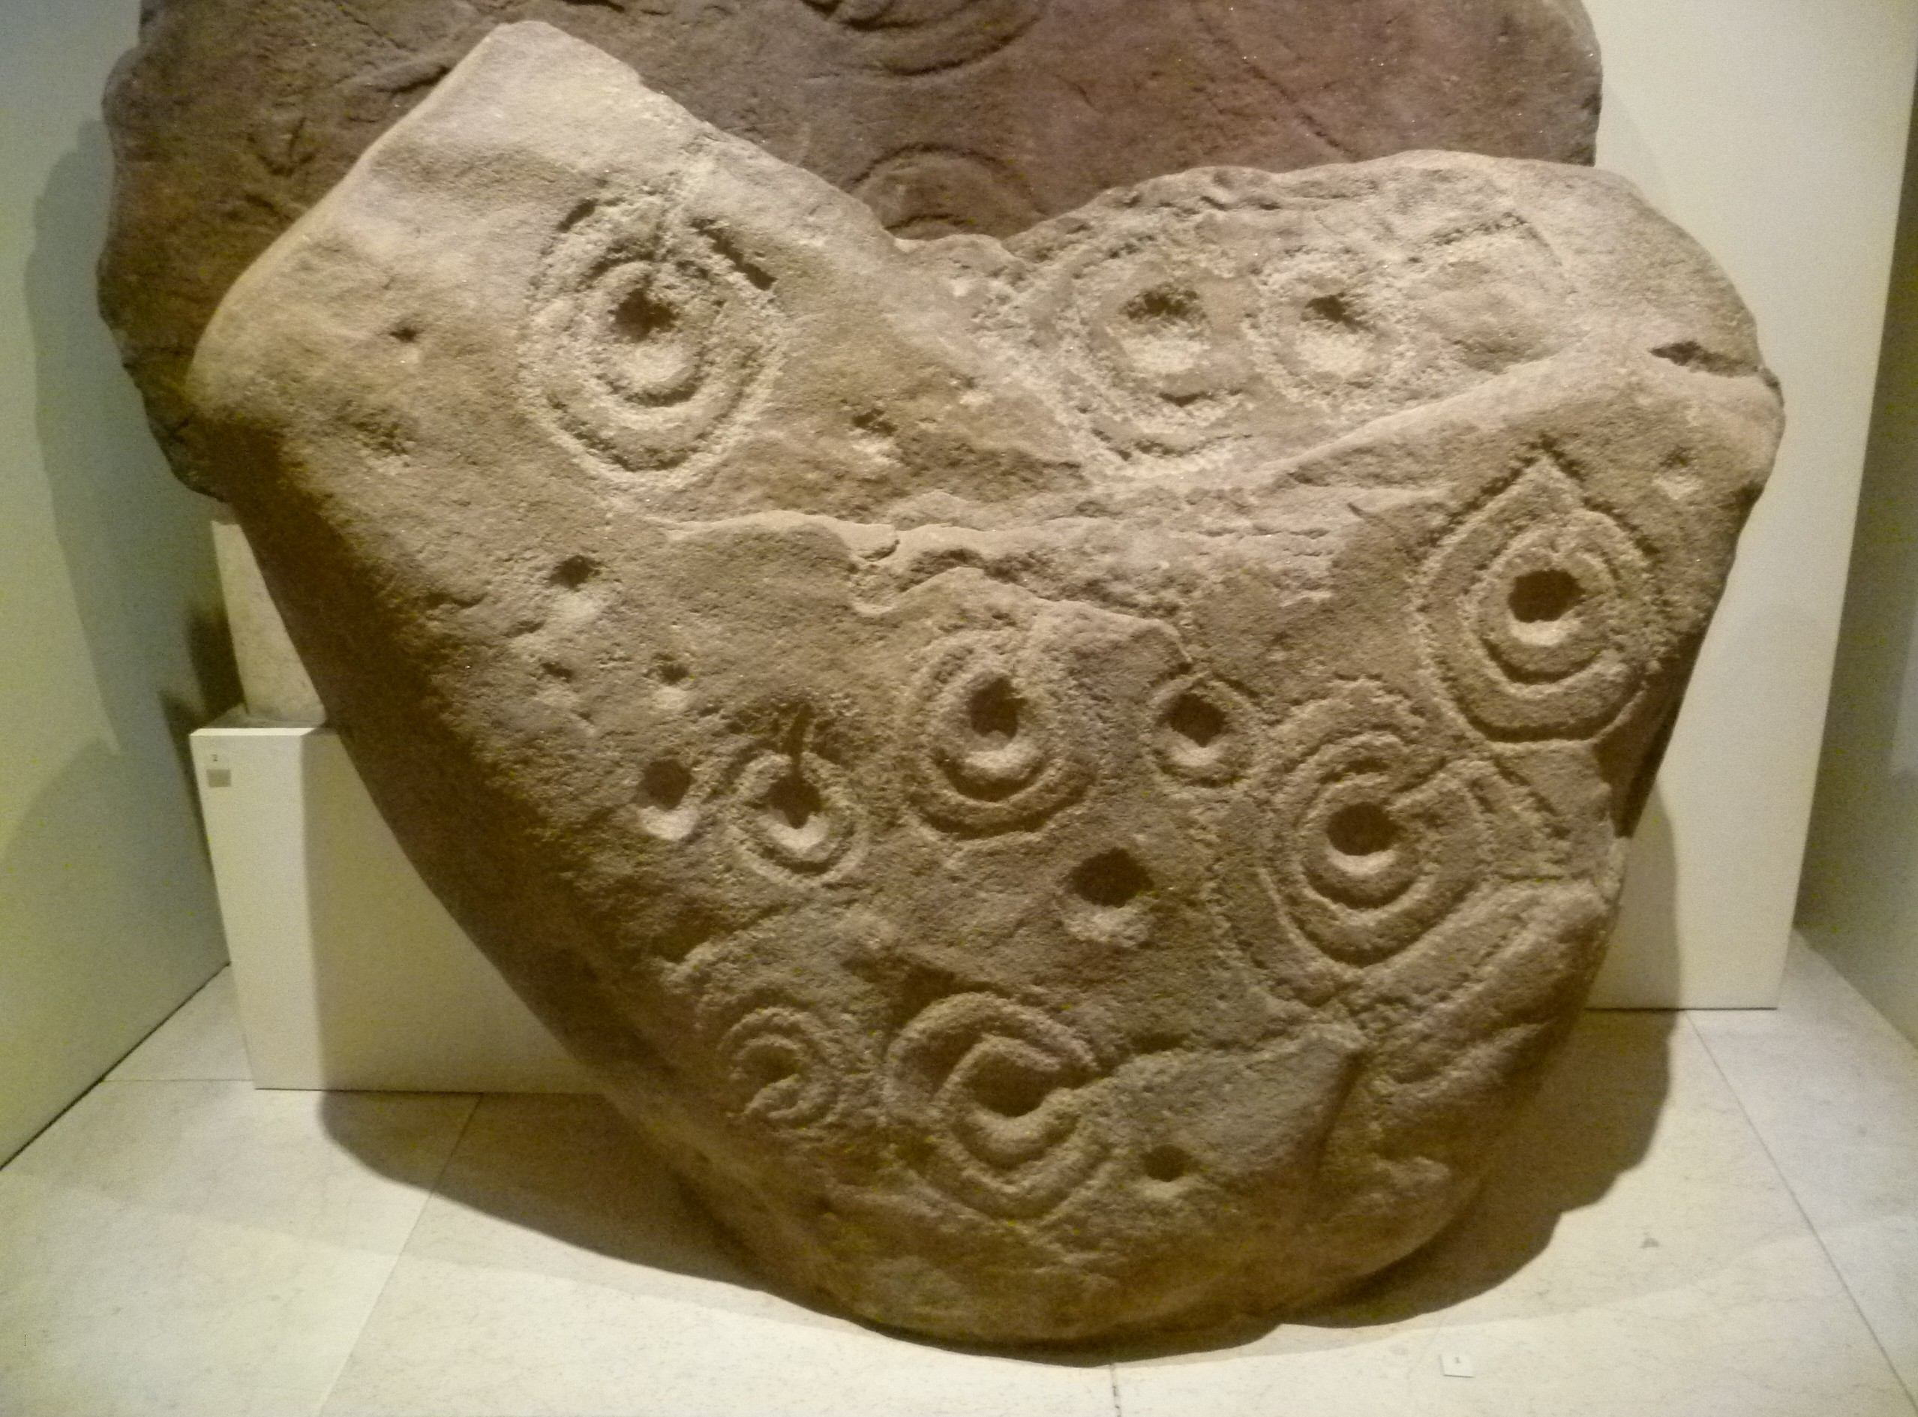
1
2
3
Where – South Africa
Purpose – Calendar?
Age- 75,000 Years Old - Oldest Man Made Structure?
Where – East Bay, CA
Purpose – Unknown
Age – Unknown, Native Americans didn’t build them?
Where – Syria to Saudi Arabia, Similar ones in Peru
Purpose – Ritual?
Age – Unknown - Prehistoric to 2000 years old
5
6
4
Where – Scotland
Purpose – Decoration?
Age - Prehistoric
Where – Southern Africa
Purpose – Energy Grid?
Age – 180,000 Years Old
Where - Jordan
Purpose – Unknown
Age – Prehistoric?

Slide 9
Sketch of Syrian Wheels
Sketch of Jordan Circle

Slide 10
Notes
Shapes
What shapes do you notice? What do you think they used to make those shapes?
Which locations would be easy to figure out the shape in person?
Which shapes would be harder to notice from the ground?
Purpose
Why don’t we know what all of these were used for?
Why would people need a calendar?
Any ideas what else these might be used for?

Slide 11
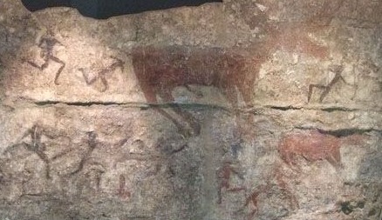
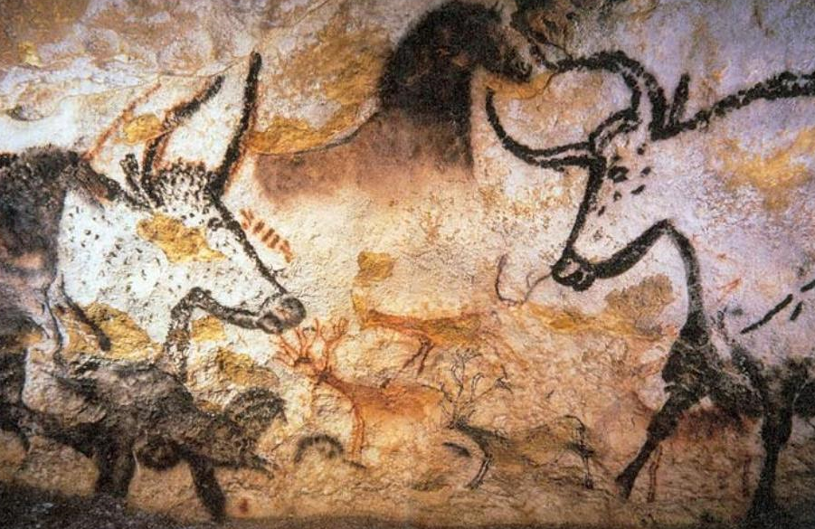
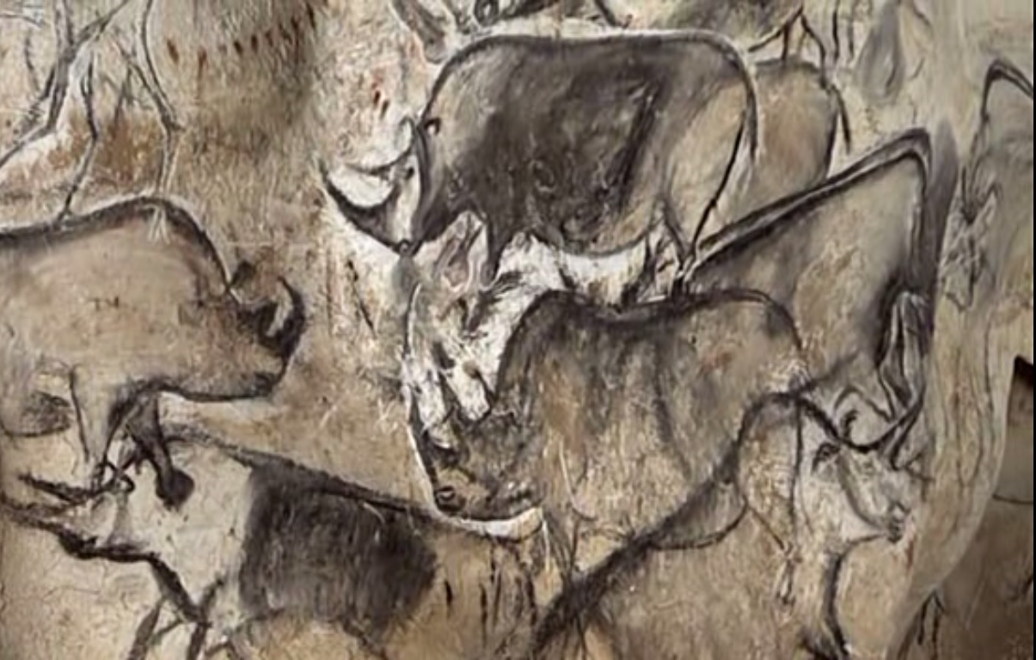
çatalhöyük Mound, Turkey
Approximate Date: 7000 BC
Lascaux Cave, France
Approximate Date: 15,000 BC
Chauvet Cave, France
Approximate Date: 32,000 BC

Slide 12
Sketch of a Cave Drawing

Slide 13
Notes
Drawings
What animals do you see?
Why do you think people drew these?
Which cave has the oldest drawings?
Origin of Numbers
Which do you think came first – paintings or numbers? Why?
How would you describe the number of animals you see without using numbers? Without language?
Guess which numbers are “hard-wired” into our brains.

Slide 14
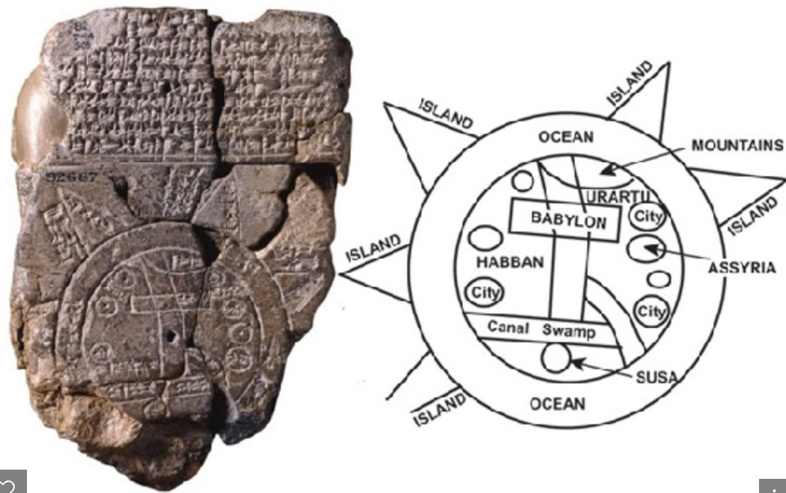
Ancient Math

Slide 15
Circle Time!!
Small Circle:
Diameter (D): _____________________
Circumference (C): _________________
C divided by D: ____________________
Medium Circle:
Diameter (D): _____________________
Circumference (C): _________________
C divided by D: ____________________
Big Circle:
Diameter (D): _____________________
Circumference (C): _________________
C divided by D: ____________________

Slide 16
Find the Average of Your C/D Measurement
Small Circle: C divided by D _____________
Medium Circle: C divided by D _____________
Big Circle: C divided by D _____________
Add those together _____________
Divide that by 3 _____________
You just found an approximate value of . . .

Slide 17
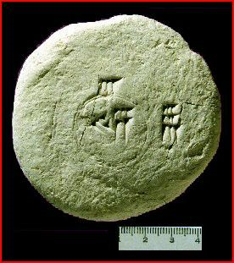
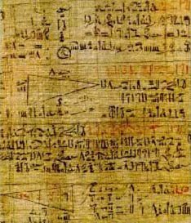
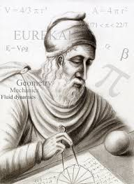
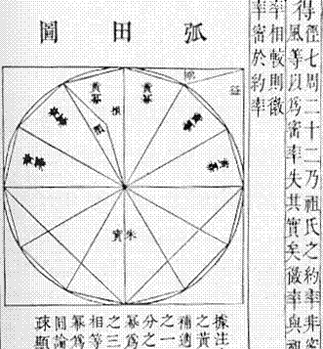
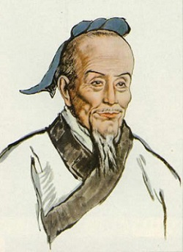
Approximate Values of Pi – add your name to the list!
1900–1680 BC Babylonia 3.125
1650 BC Egypt 3.1605
250 BC Greece 3.1429 to 3.1408
Archimedes
287–212 BC China 3.1415926 and 3.1415927
Zu Chongzhi

Slide 18
Notes
Circle Time!
What two parts of the circle did you use to find pi?
What did you do with those parts to find pi?
What is the number that is always the same no matter how big or small a circle is?
Pi
Which place came up with the first calculation of pi that we know of?
Who came up with the best approximation of pi (the closest to the actual number?
How many years did it take to get from the first approximation to the best approximation?

Slide 19
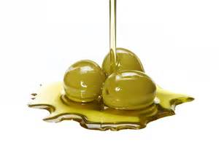
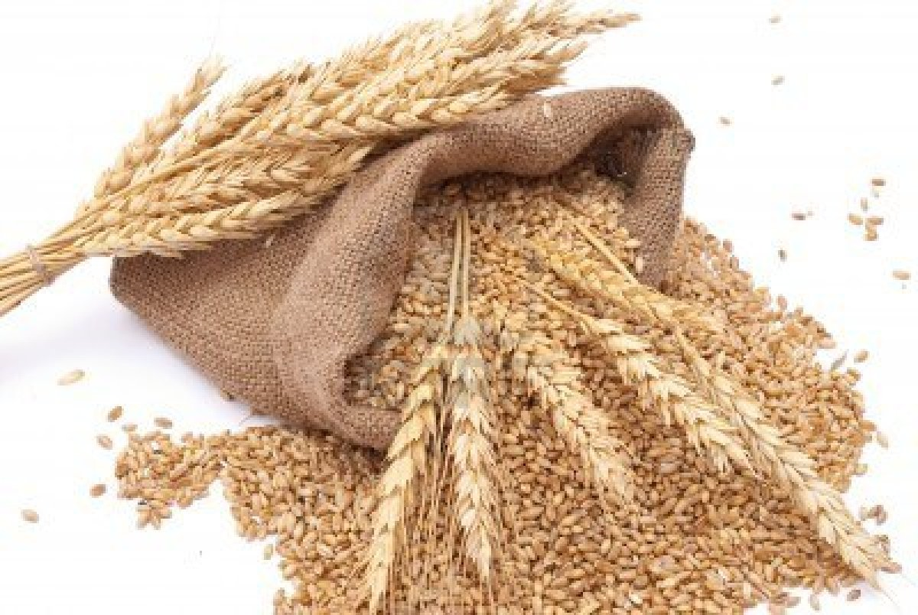
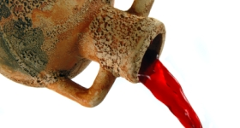
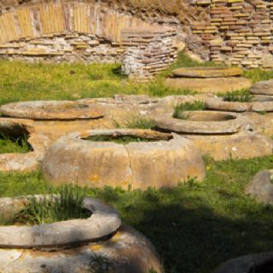
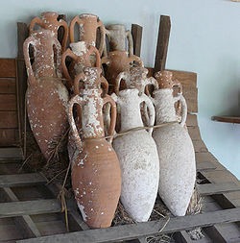
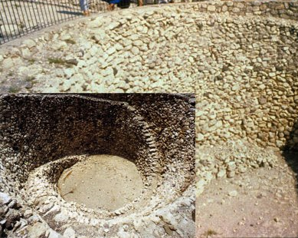
Olive Oil
Stored in Jars and Amphora
Oldest Known: 5800 BC
Wine and Beer
Stored in Amphora
Oldest Known: 6000 BC
Grains: Wheat, Barley, Amaranth
Stored in Silos
Oldest Known: 9500 BC

Slide 20
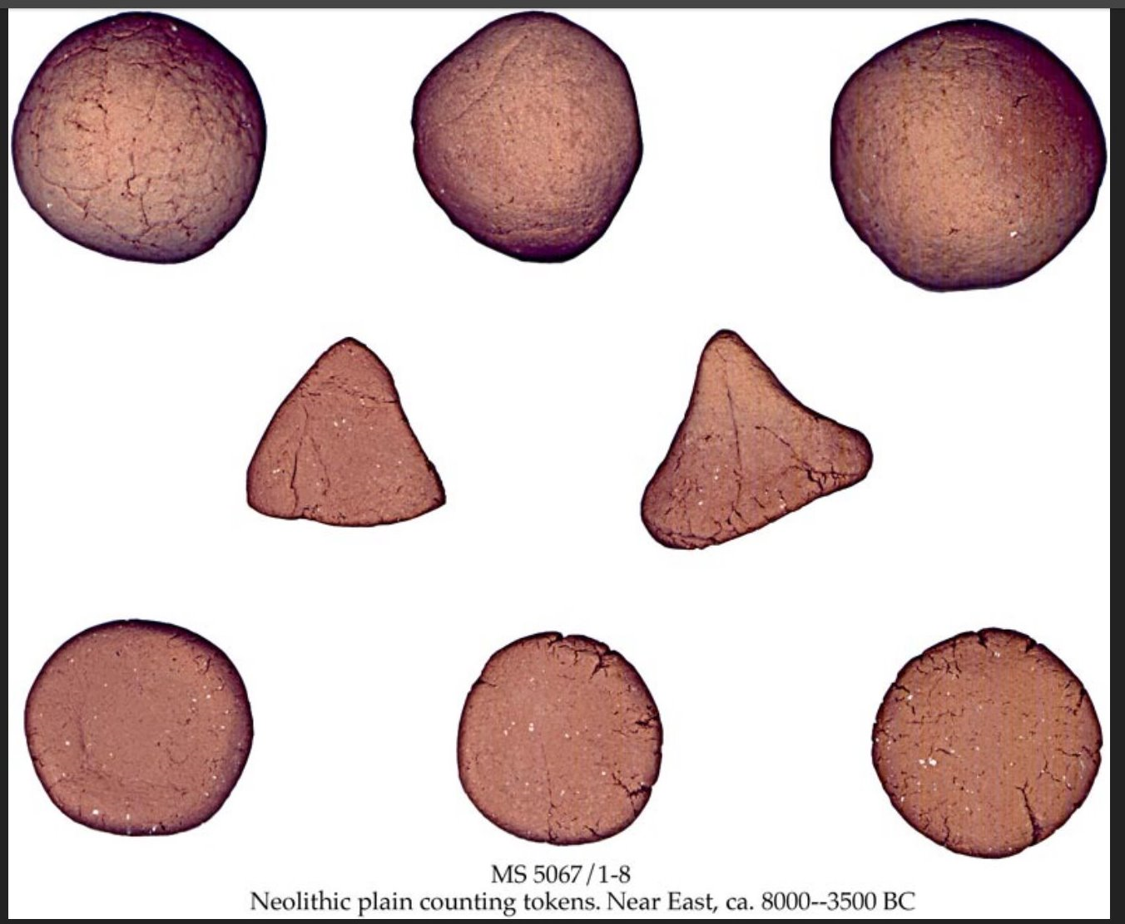
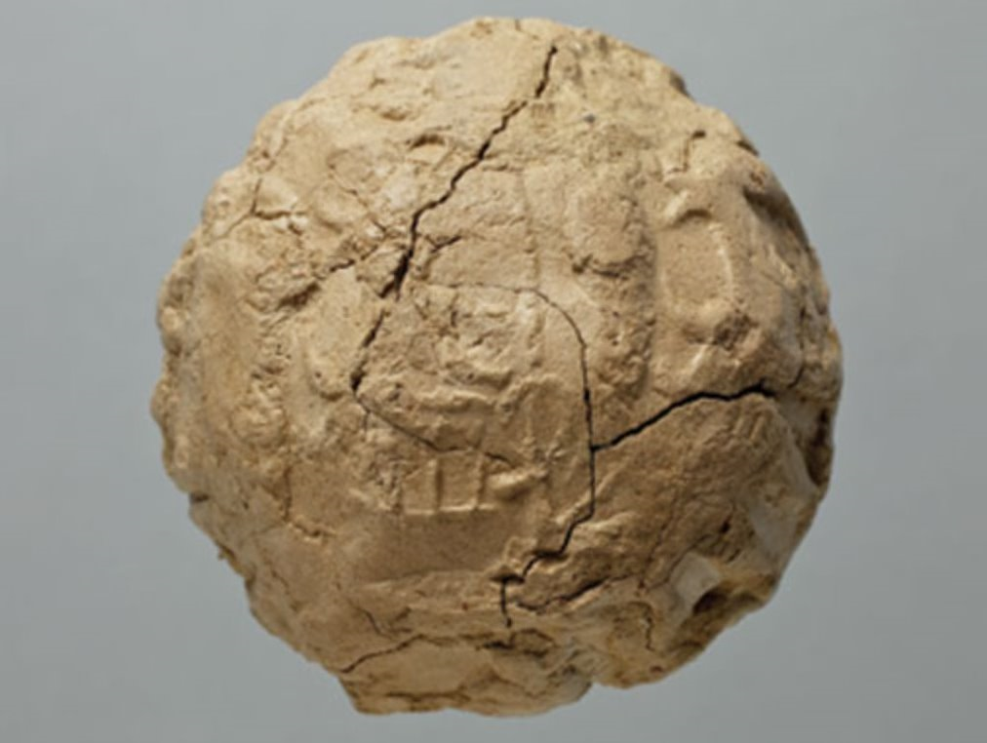
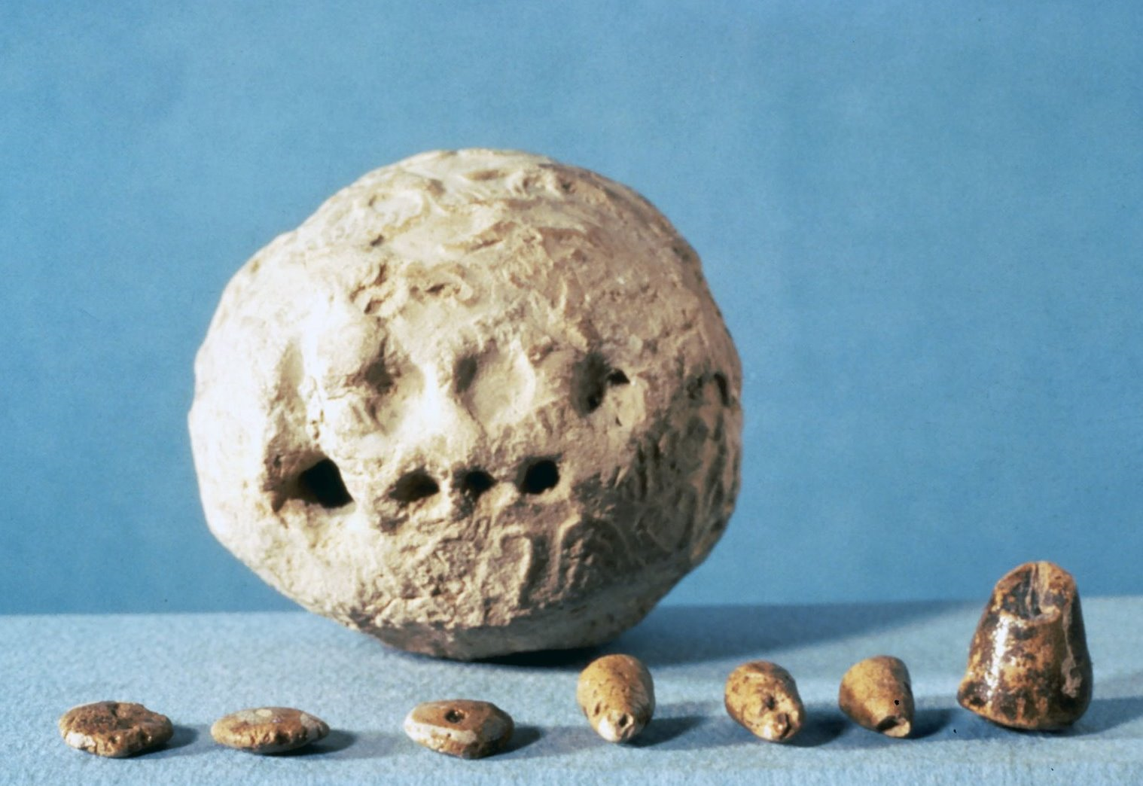
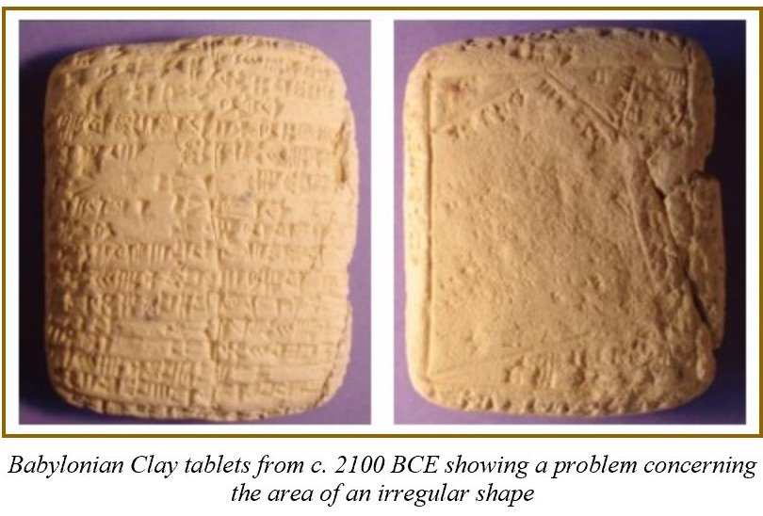
1
2
3
4

Slide 21
Notes
Growing Food
How did farming create the need for math?
What type of information did people need to record?
What was one kind of storage system used?
Clay Tokens, Envelopes, and Tablets
What were the tokens in Picture 1 used for?
What does Picture 2 show?
What was the big leap from Picture 2 to Picture 3?
What does Picture 4 show?

Slide 22
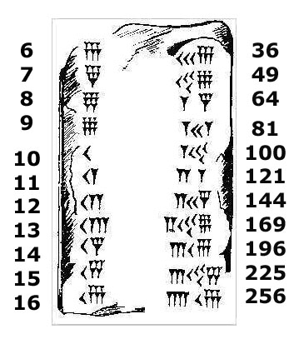
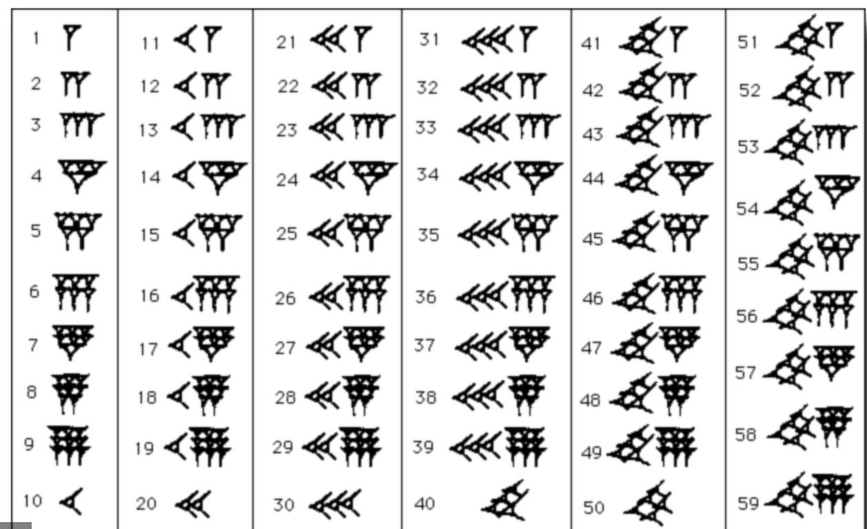

Slide 23
Notes
Write the numbers in Cuneiform on the tablets:
4 15 35 64 127 632
First Number System!!!
How many symbols are there?
What did the Babylonian’s use to write math?
What type of problems do you see with this number system?

